Slide 1



X
Business Performance Analytics 2020-2023
Kimia Farma - Big Data Analytics
Presented by
Husnia Munzayana

Slide 2

Disclaimer
Anda dapat mengganti design template ini sesuai kreativitas kalian. Anda dapat menambahkan slide sesuai kebutuhan.
Template ini hanya bertujuan untuk memberikan gambaran isi konten yang wajib dibuat oleh peserta. SIlahkan hapus slide ini setelah anda membuat salinan dokumen ini di drive Anda

Slide 3





Insert your photo here
Husnia Munzayana
Undergraduate Student of Informatics at Institut Teknologi Bandung
I am from Sragen, Central Java. Previously, I received my education at SMA Negeri 1 Surakarta. Currently, as a third-year student majoring in Informatics at Bandung Institute of Technology, I bring a foundation in data science and full-stack website development. Through coursework and hands-on projects, I've honed my skills in programming languages, database management, and web development frameworks, enabling me to excel in roles that require analytical thinking and creative problem solving within the computer science field.
Bandung, West Java
husniamunzayana.7802@gmail.com / 13521077@std.stei.itb.ac.id
https://www.linkedin.com/in/husnia-munzayana/

Slide 4

About Company
Kimia Farma is a pharmaceutical company based in Indonesia. It is one of the oldest and largest pharmaceutical companies in the country, with a history dating back to 1817. Originally established as a Dutch colonial pharmacy, Kimia Farma has since evolved into a modern pharmaceutical company engaged in the manufacture, distribution and retailing of pharmaceutical products, medical devices and healthcare services. The company operates in several segments, including prescription drugs, over-the-counter drugs, herbal medicines and healthcare facilities. Kimia Farma plays a significant role in Indonesia's healthcare sector, providing essential medicines and healthcare solutions to the population.

Slide 5
Project Portfolio
As a big data analytics intern at Kimia Farma, I was assigned to analyze the company's business performance for the years 2020 to 2023. My responsibilities include creating analysis tables and presenting reports through dashboards to evaluate Kimia Farma's business performance during the specified time period. The analysis table was implemented using the BigQuery platform, while the dashboard was developed using Looker Studio.
The provided dataset consists of the following tables:
kf_final_transaction
kf_inventory
kf_kantor_cabang
kf_product
From that dataset, we were asked to create a data analysis table from the existing raw data and visualize the company's performance report with a dashboard.
Project Repository here!
https://github.com/munzayanahusn/VIX-Kimia-Farma-Data-Analytics.git
Project explanation video here!
https://youtu.be/frSdz65cFKQ

Slide 6
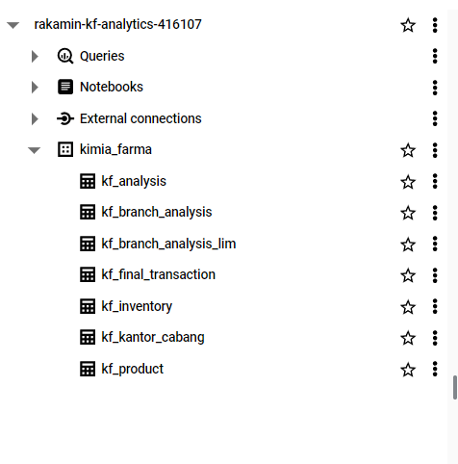
Importing Dataset to BigQuery
In the first task, I was asked to import the four records provided:
kf_final_transaction.csv
kf_inventory.csv
kf_kantor_cabang.csv
kf_product.csvFirst,
I created a new project in BigQuery Studio Google Cloud named "Rakamin-KF-Analytics". Then I created a new dataset named "kimia_farma". Then I imported the provided tables into the kimia_farma dataset.

Slide 7
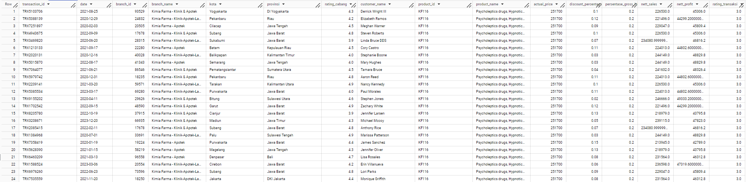
Tabel Analisa
In the second task, I was asked to create an analysis table based on the aggregated results of the four tables, based on the aggregated results of the four tables that have been imported before.
Therefore, I created an SQL query to be able to display the mandatory analysis columns that have been determined. The analysis query can be seen in the repository in the `query.sql` file.

Slide 8
BigQuery Syntax
CREATE TABLE kimia_farma.kf_analysis AS
SELECT tr.transaction_id,
tr.date,
tr.branch_id,
kc.branch_name,
kc.kota,
kc.provinsi,
kc.rating AS rating_cabang,
tr.customer_name,
tr.product_id,
pd.product_name,
pd.price AS actual_price,
tr.discount_percentage,
CASE
WHEN pd.price <= 50000 then 0.1
WHEN pd.price > 50000 AND pd.price <= 100000 then 0.15
WHEN pd.price > 100000 AND pd.price <= 300000 then 0.2
WHEN pd.price > 300000 AND pd.price <= 500000 then 0.25
ELSE 0.3 --pd.price >500000
END AS persentase_gross_laba,
(pd.price * (1-tr.discount_percentage)) AS nett_sales,
((tr.price * (1-tr.discount_percentage)) - pd.price)AS nett_profit,
tr.rating AS rating_transaksi
FROM kimia_farma.kf_final_transaction AS tr
LEFT JOIN kimia_farma.kf_kantor_cabang AS kc
ON (tr.branch_id = kc.branch_id)
LEFT JOIN kimia_farma.kf_product AS pd
ON (tr.product_id = pd.product_id)
;
CREATE TABLE kimia_farma.kf_branch_analysis_lim AS
SELECT kc.branch_id,
kc.branch_name,
AVG(tr.rating) AS rating_transaction,
kc.rating AS rating_branch
FROM kimia_farma.kf_kantor_cabang AS kc
LEFT JOIN kimia_farma.kf_final_transaction AS tr
ON (kc.branch_id = tr.branch_id)
GROUP BY kc.branch_id, kc.branch_name, kc.rating
ORDER BY AVG(tr.rating) ASC, kc.rating DESC
LIMIT 5
;

Slide 9
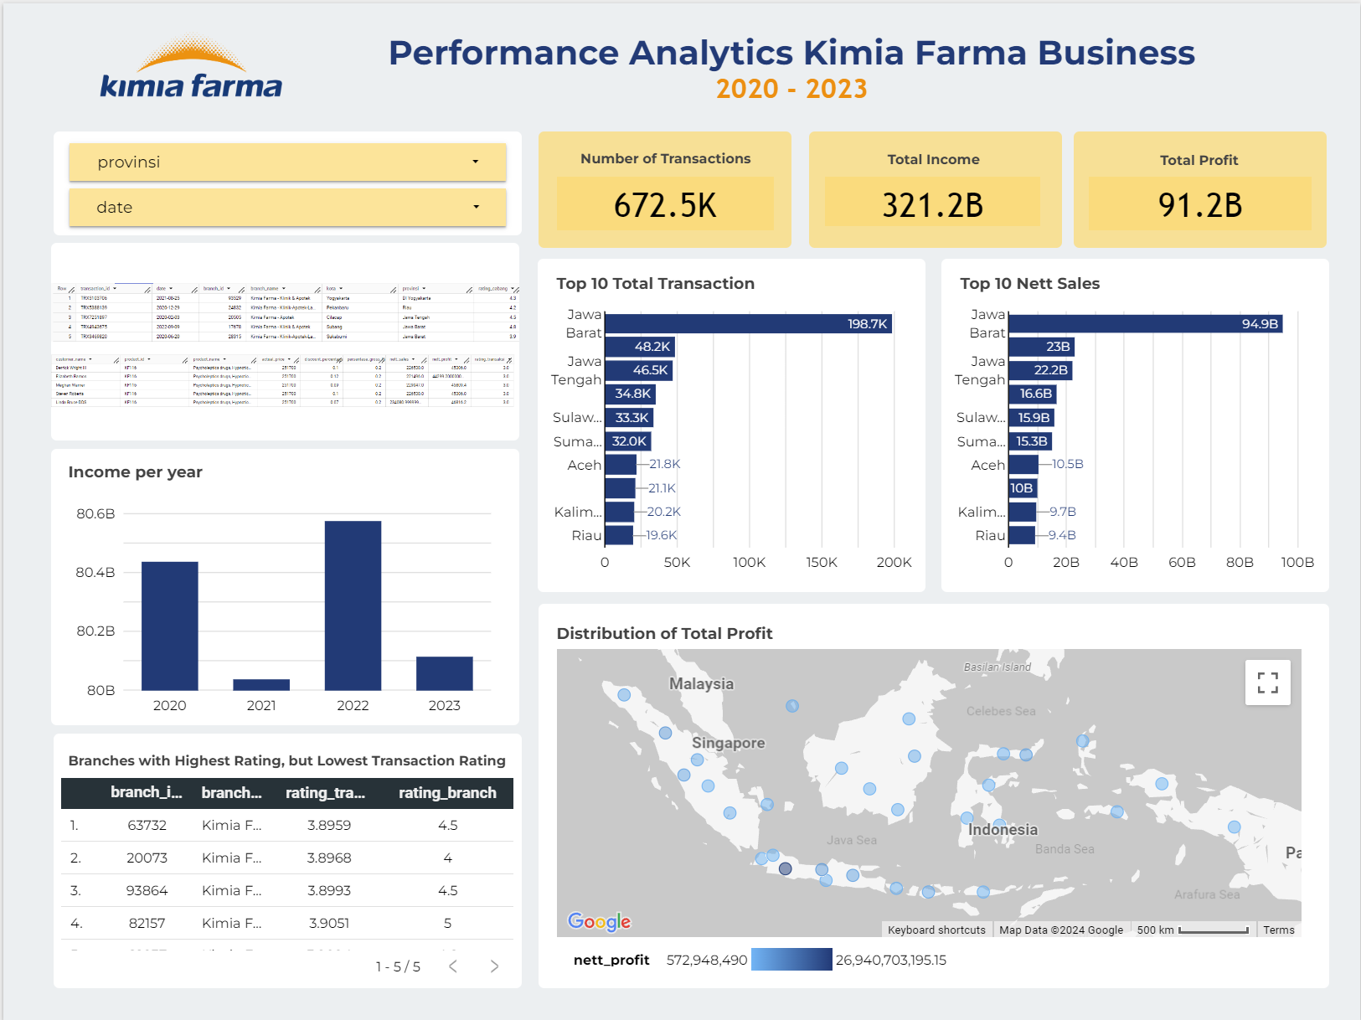
Dashboard Performance Analytics
Next, I was asked to create a performance analysis visualization in the form of a dashboard built through Looker Studio.
Project Dashboard here!
https://lookerstudio.google.com/s/qgr_JPexnm8

Slide 10
Thank You
X

